Slide 1




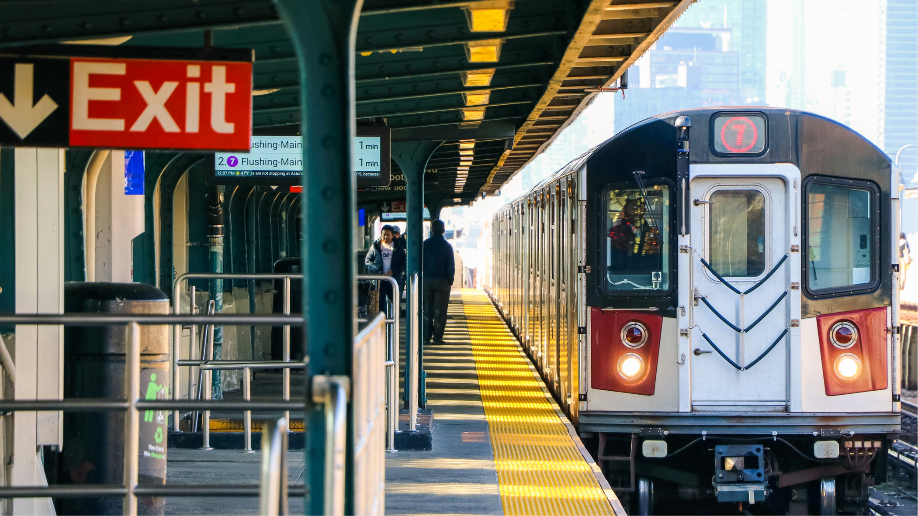

UI/UX REDESIGN OF EGYPTIAN NATIONAL RAILWAYS
HCI - Project

Slide 2





1- our team :
Mohamed Ali Abdelwahab
Mahmoud Ahmed Omeish
Huda Muhammed Hamza
Youmna Ahmed Abdullah
Salma Sameh Aboelmaged
team members&
sumbmition info
submitted to :
Dr . Osama Ghoniem
Eng. Omar Khaled

Slide 3


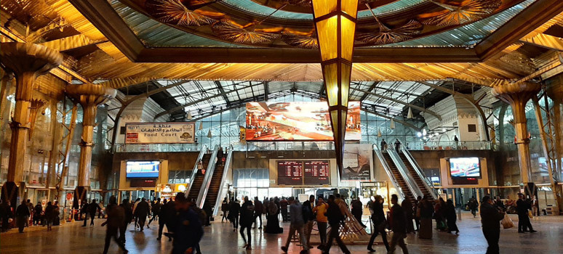



Introduction
This project involves the UI/UX Redesign of the official website for the Egyptian National Railway (ENR).
This website is a vital gateway for millions of users to book train tickets. Therefore, the quality of the user experience directly impacts user satisfaction, service efficiency, and the accessibility of a fundamental public service.

Slide 4


The Problem Statement (The Current Website)
Despite its importance, an initial UX audit revealed significant weaknesses in the current website's usability, legibility, and visual aesthetics. These issues result in a frustrating and inefficient user journey, particularly during critical processes like searching for trips and selecting seats, ultimately compromising accessibility and lowering task completion rates.
The Problem Statement
next slide

Slide 5
The core goal is to transform the website into a platform that is more intuitive, effective, and visually appealing.
The redesign focuses on enhancing readability, strengthening the Visual Hierarchy, and ensuring design Consistency, thereby providing a seamless and reliable ticket booking experience for the Egyptian user base.
The Redesign Objective
next slide

Slide 6
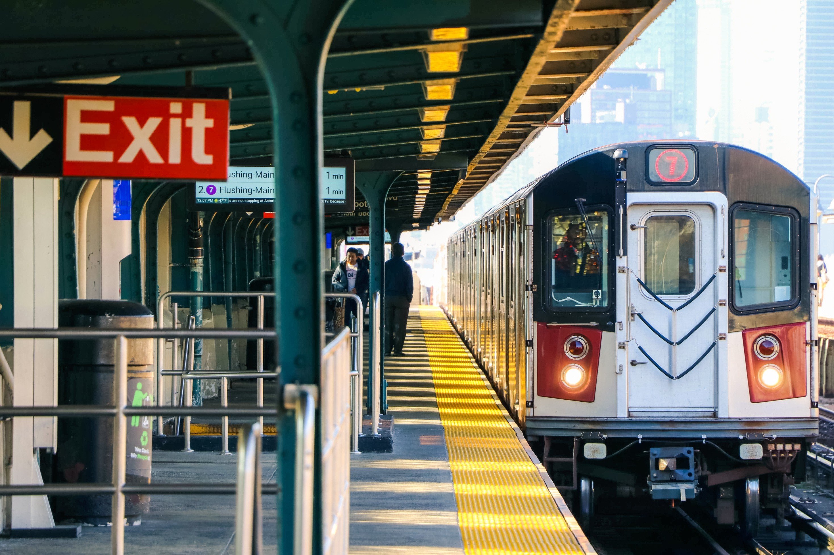

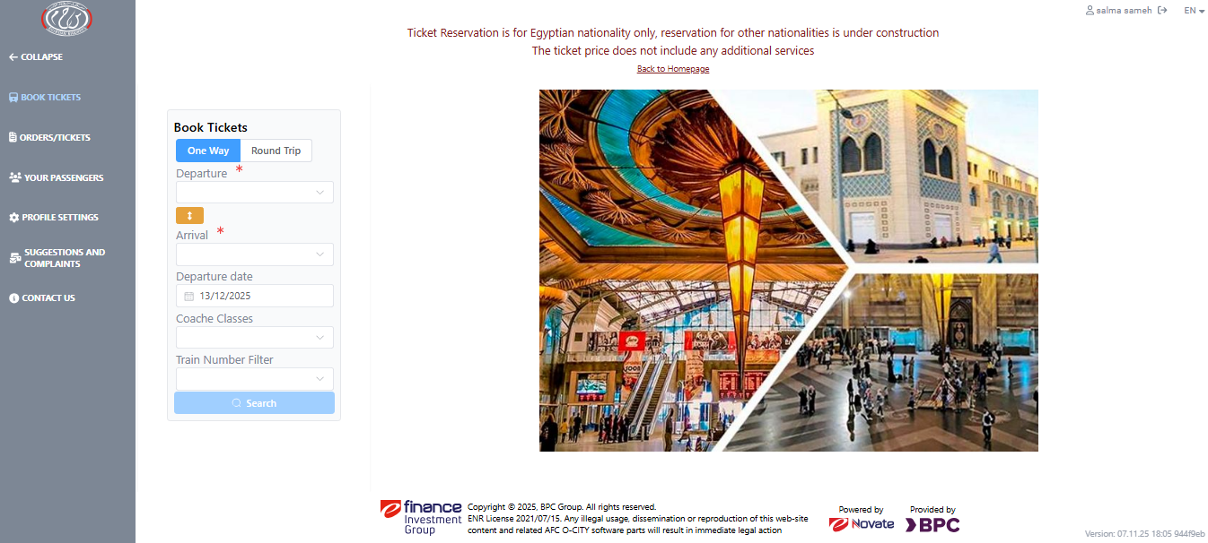
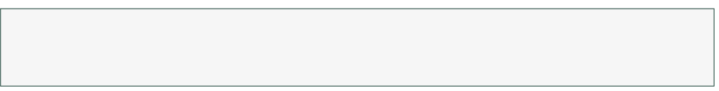
1- sidebar Pain Points
- Uppercase text which violates readability standards
- Layout shift when menu collapses leading to bad user experience
- Low contrast between labels and background makes readability harder
- collapse looks identical to other menu items which breaks visual grouping

Slide 7
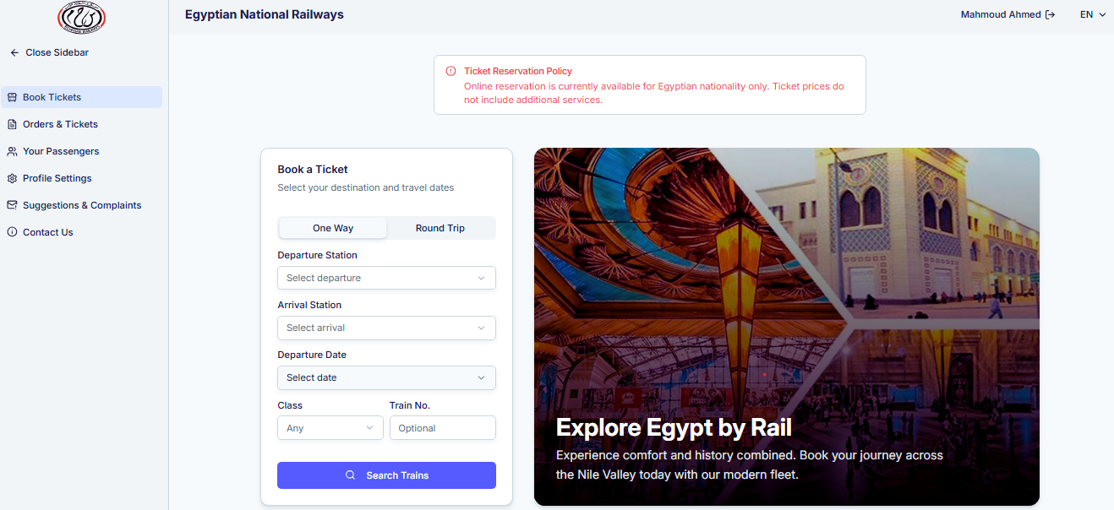
1- sidebar Improvements
-Title case labels instead of all caps, more readable text
-separated collapse menu from primary navigation
-suitable contrast between labels and background

Slide 8
Violated UI/UX Principles (sidebar)
Readability & Legibility
• All-caps text and low text–background contrast reduce readability.
Visual Hierarchy
• No clear emphasis on primary actions; collapsible items look identical to regular items.
Consistency
• Inconsistent spacing and uniform styling for elements with different functions.
Spacing & Layout
• Cramped layout, uneven gaps, and layout shifts during sidebar collapse.
Accessibility
• Low contrast violates WCAG standards; important notices are not visually highlighted.

Slide 9
2- search form Pain Points
- inconsistent spacing, uneven gaps and cramped layout
- image lacks context and purpose
- no clear primary action and weak visual hierarchy, search button blends in
- important notice at the top isn't visible and blends in

Slide 10
2- search form Improvements
1-clear visual hierarchy, prominent primary action "search trains"
2- consistent spacing with more whitespace creating a relaxed layout
3-adding overlay to image gives it meaning
4- alert banner shows notice upfront & draws attention
5- user guidance using placeholders

Slide 11
Violated UI/UX Principles ( search form )
Feedback & Clarity
• Collapsible items lack visual feedback; search button blends with the UI.
Information Architecture
• Poor grouping between primary navigation and collapsible sections.
Affordance
• Buttons and collapsible elements don’t visually indicate their interaction behavior.
Clarity of Purpose
• Background image lacks context; missing instructional placeholders.

Slide 12
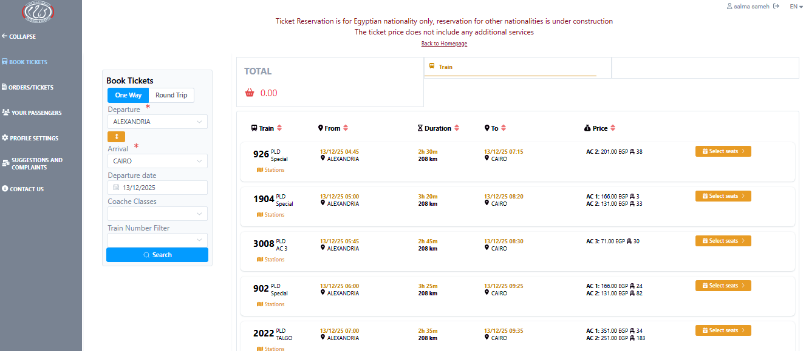
3- train results Pain Points
- weak hierarchy: train info, times, prices, and actions compete for attention
- dense layout & visual clutter: grid with many columns makes scanning difficult
- no clear grouping: related info (departure/arrival, duration, price) isn’t grouped
- inconsistent spacing
- price info buried in dense text
- typography inconsistency: multiple font sizes without clear pattern

Slide 13
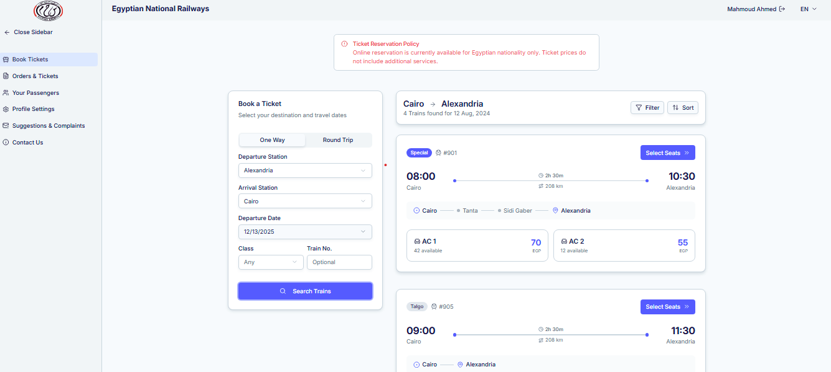
3- train results Improvements
- structured sections & consistent spacing
- price prominence: large, bold prices in primary color
- different colors for low and sold out seats draw user attention

Slide 14
Violated UI/UX Principles (Train Results)
Visual Hierarchy
Important information doesn’t stand out.
Spacing & Layout
The layout feels crowded and hard to follow.
Information Architecture / Grouping
Related details are not grouped together.
Readability & Scannability
Hard to quickly read or find key information like price.
Consistency (Typography)
Fonts and sizes are not used consistently.

Slide 15
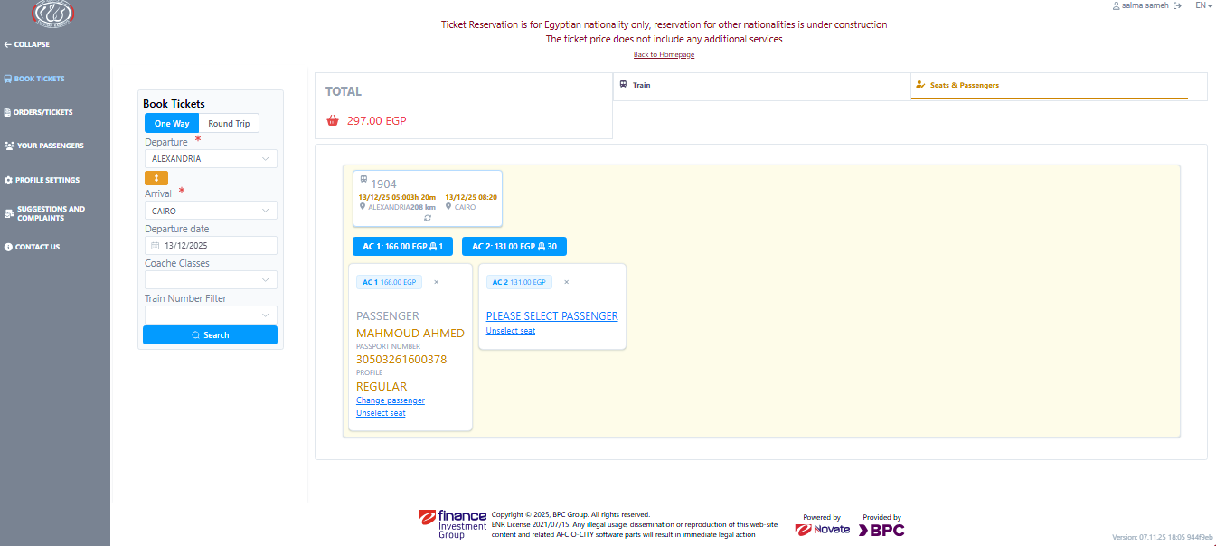
4- book seats Pain Points
- poor Visual Hierarchy & no clear focus point, everything competes for attention
- Insufficient white Space: elements are cramped making scanning difficult
- Inconsistent color system with no cohesive palette
- inconsistent typography without clear hierarchy
- weak affordance: Important actions like "Change passenger" and "Unselect seat" look like links, not buttons.

Slide 16
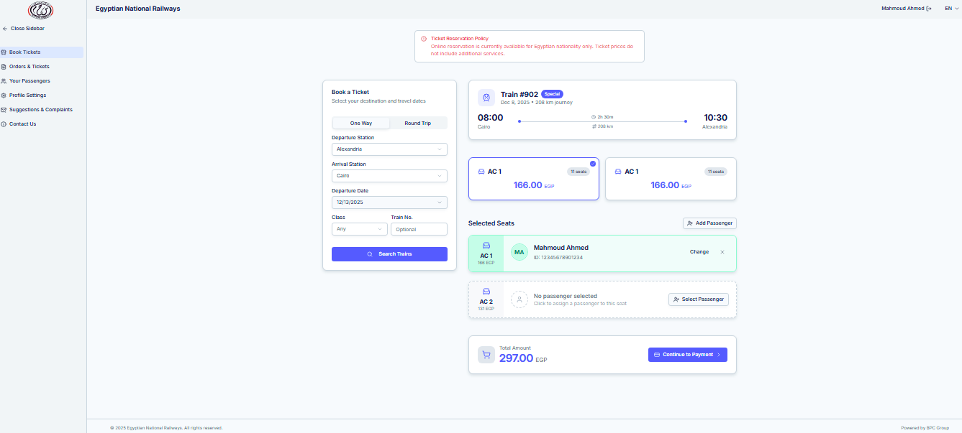
4- book seats Improvements
- clear visual hierarchy with proper type scale
- proper affordances: "Change" and "Select Passenger" are clearly buttons, not just text links
- key info (price, time, passenger) is prominent & scannable
- green border for success states draws user attention

Slide 17
Violated UI/UX Principles (Book Seats)
Visual Hierarchy
No clear focus; all elements compete for attention.
Spacing & Layout
Elements are cramped; hard to scan.
Consistency (Color & Typography)
Colors and fonts are inconsistent; no clear pattern.
Affordance
Buttons like “Change passenger” look like links, not clickable buttons.
Readability & Scannability
Key info (price, time, passenger) is not prominent.

Slide 18
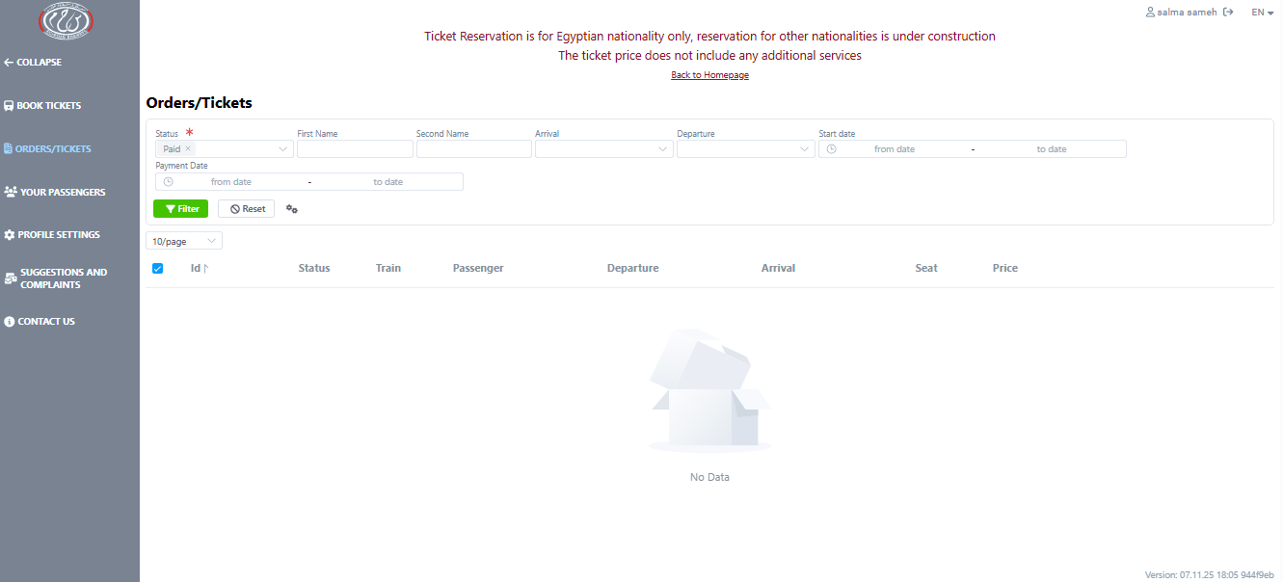
5-tickets Pain Points
- high cognitive load & visual clutter, too many filters with no clear focal point
- poor visual hierarchy & scanability, hard to see a primary action, everything competes for attention
- insufficient whitespace, layout is crammed making table harder to scan

Slide 19
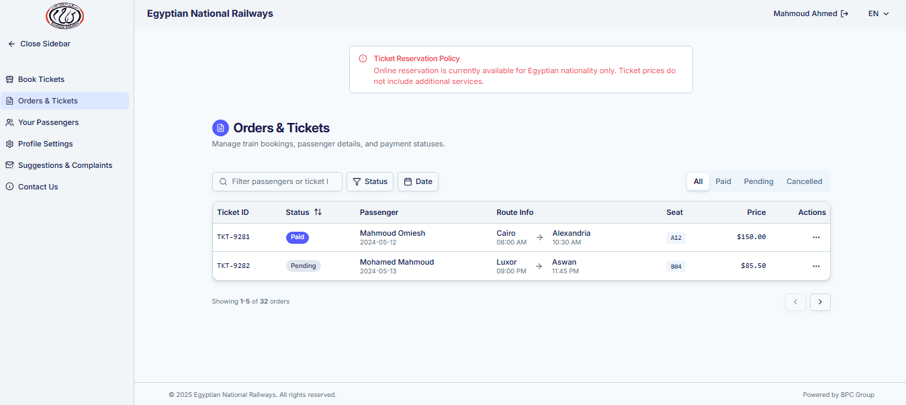
5-tickets Improvements
- clear hierarchy & sufficient whitespace
- prices are right aligned leading to easier comparison
- enhanced scanability with color coded status badges
- reduce visual clutter by combining related fields into single column

Slide 20
Violated UI/UX Principles (tickets)
Visual Hierarchy
No clear focus; all elements compete for attention.
Spacing & Layout
Elements are cramped; hard to scan.
Consistency (Color & Typography)
Colors and fonts are inconsistent; no clear pattern.
Affordance
Buttons like “Change passenger” look like links, not clickable buttons.
Readability & Scannability
Key info (price, time, passenger) is not prominent.

Slide 21
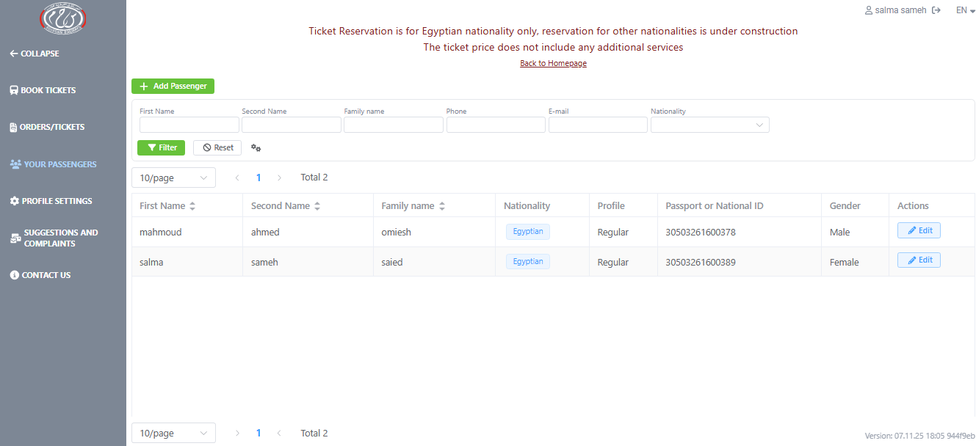
6-passengers Pain Points
- high cognitive load & visual clutter, filters, buttons, pagination and table all compete with no clear focal point
- insufficient white space, elements are crammed together making table harder to scan
- redundant pagination blocks cause visual clutter
- weak call to action, the add passenger button blends in with filter button and inputs

Slide 22
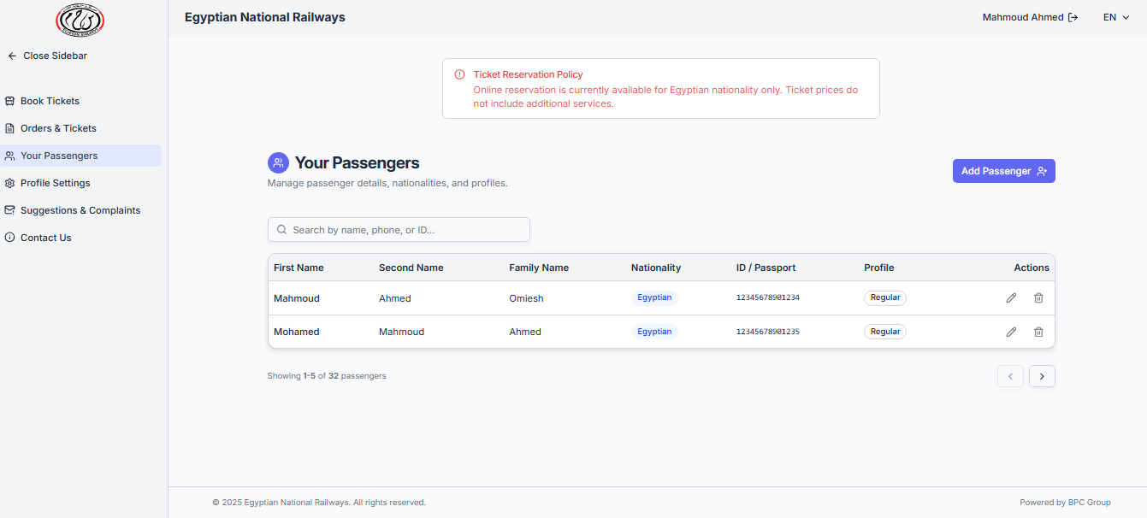
6-passengers Improvements
- clear hierarchy & sufficient whitespace
- reduced cognitive load by replacing 6 input fields with single search bar and filter dropdown
- reduced visual clutter by removing redundant pagination
- call to action is prominent and draws user attention

Slide 23
Violated UI/UX Principles (passangers)
Visual Hierarchy – Too many elements competing, no clear focus.
Cognitive Load – Multiple filters and controls shown at once overwhelm the user.
Whitespace – Tight spacing makes the table harder to read.
Scanability – Cluttered layout (including redundant pagination) hurts quick scanning.
Call-to-Action Clarity – “Add Passenger” doesn’t stand out as the primary action.

Slide 24
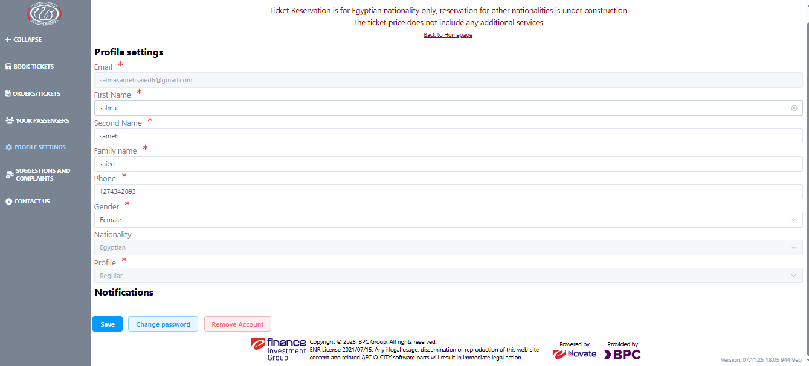
7-settings Pain Points
- poor visual hierarchy, the 2 main sections (settings & notifications) aren't visually separated
- content touches the edge of the screen causing visual noise and makes reading harder
- unclear call to action, the three action buttons are grouped together, failing to prioritize the primary action
- lacks clarity, no empty-state for the notifications list when it is empty

Slide 25
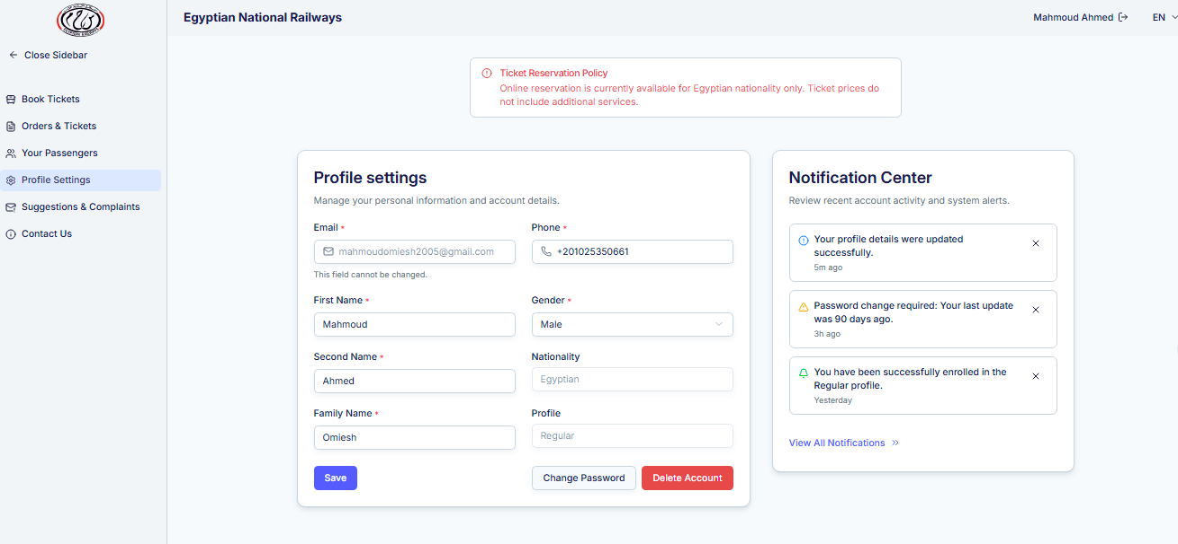
7-settings Improvements
- improved visual hierarchy & grouping, separating profile from notifications reduces cognitive load
- clear call to action and separation from destructive delete profile
- sufficient whitespace to keep content off the screen edges, improving readability and reducing visual noise.

Slide 26
Violated UI/UX Principles (settings)
Visual Hierarchy – Sections (Settings & Notifications) aren’t visually separated.
Whitespace – Content touches screen edges, creating visual noise.
Call-to-Action Clarity – Action buttons are grouped, primary action isn’t prioritized.
Clarity / Empty State – Notifications list has no empty-state, reducing clarity.

Slide 27
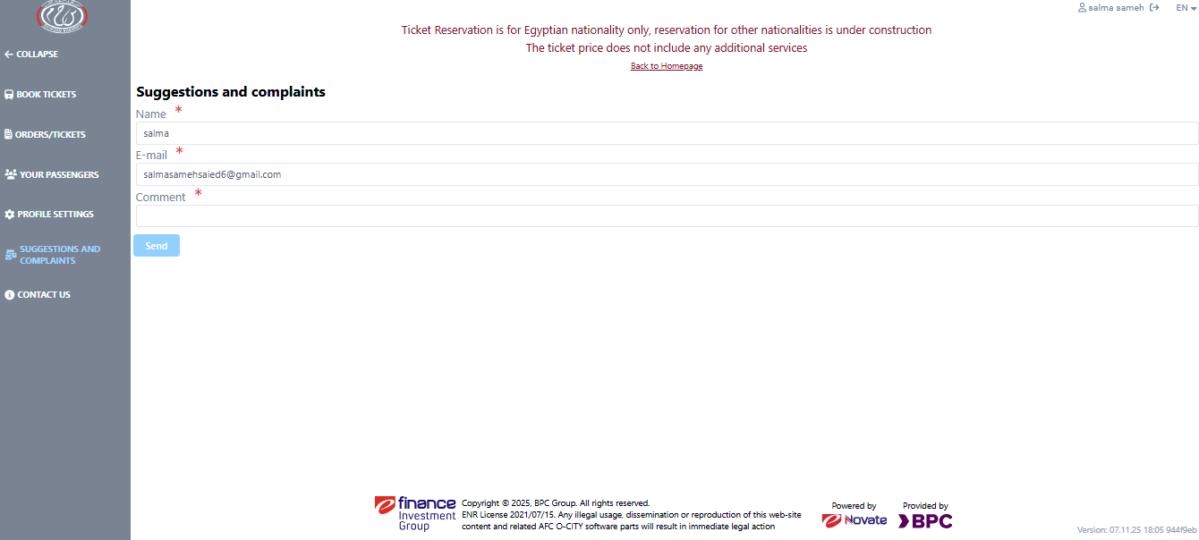
8-complaints Pain Points
- insufficient white space creating a crowded effect
- content touches the edge of the screen causing visual noise
- weak affordance with comment field, users expect multi-line input
- weak call to action, the grayed out button blends too much with the background
- no feedback, users don't know what happens after submission

Slide 28
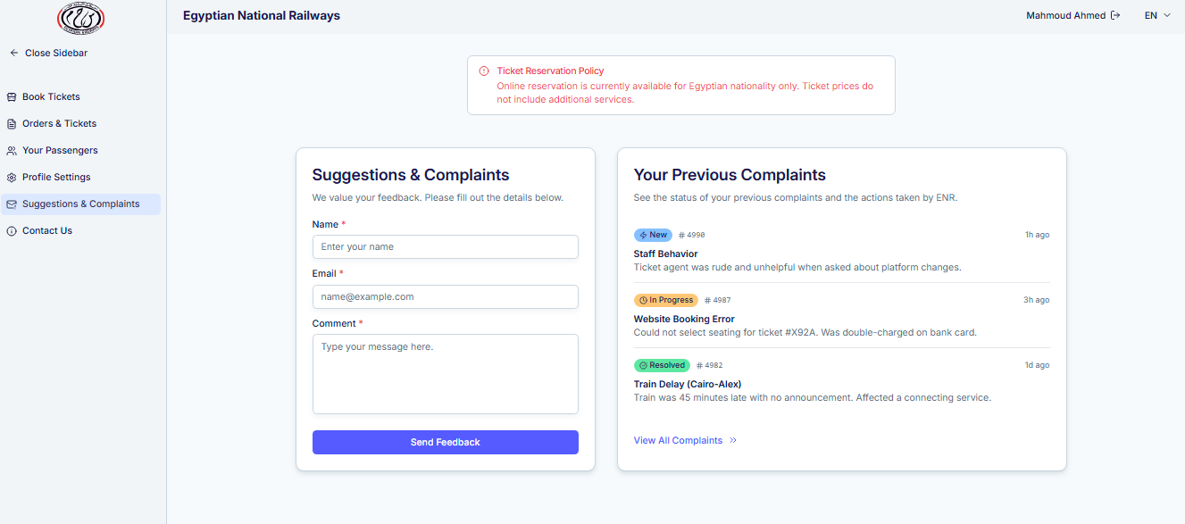
8-complaints Improvements
- clear structure & hierarchy and sufficient whitespace
- strong affordance with comment field using multi-line input
- call to action is prominent and draws user attention
new features:
- users can now view their past complaints and their resolution

Slide 29
Violated UI/UX Principles (complaints)
Whitespace – Layout is crowded; content touches screen edges.
Affordance – Comment field doesn’t clearly indicate multi-line input.
Call-to-Action Clarity – Submit button blends into background, hard to notice.
Feedback / System Status – No indication of what happens after submission.
Visual Hierarchy – Overall structure makes it harder to distinguish important elements

Slide 30
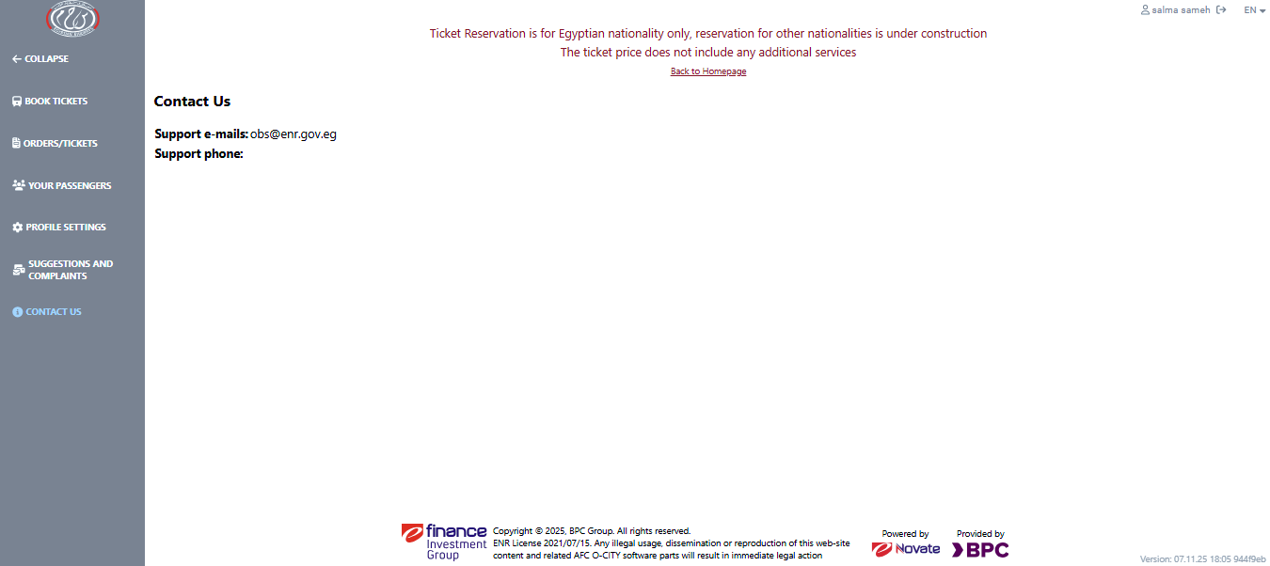
9-contact Pain Points
- poor information visibility, phone field is empty
- poor visual hierarchy & insufficient white space between contact methods
- weak affordance, no buttons to suggest "tap to email/call"
- missing guidance, no hints about response time or working hours

Slide 31
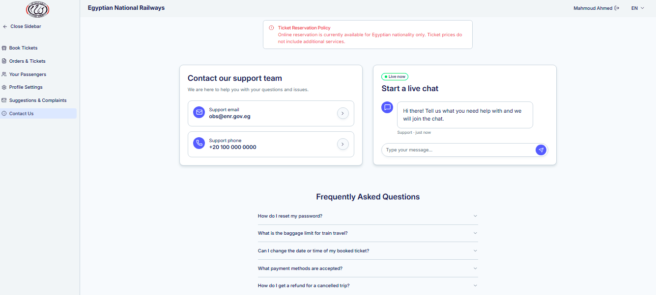
9-contact Improvements
- clear hierarchy and grouping making primary tasks easy to find
- strong affordance, mail/phone rows buttons so users know how to act.
- guidance and context, descriptive titles and helper text reduce cognitive load
new features:
- live chat gives users an immediate support option that reduces wait times
- FAQ section to answer common questions

Slide 32
Violated UI/UX Principles (contact)
Information Visibility – Phone field is empty, so users can’t see essential info.
Visual Hierarchy – Contact methods aren’t clearly separated; primary tasks aren’t obvious.
Whitespace – Elements are too close together, making scanning harder.
Affordance – No buttons or cues to indicate “tap to email/call.”
Clarity / Guidance – Missing hints about response times or working hours.

Slide 33

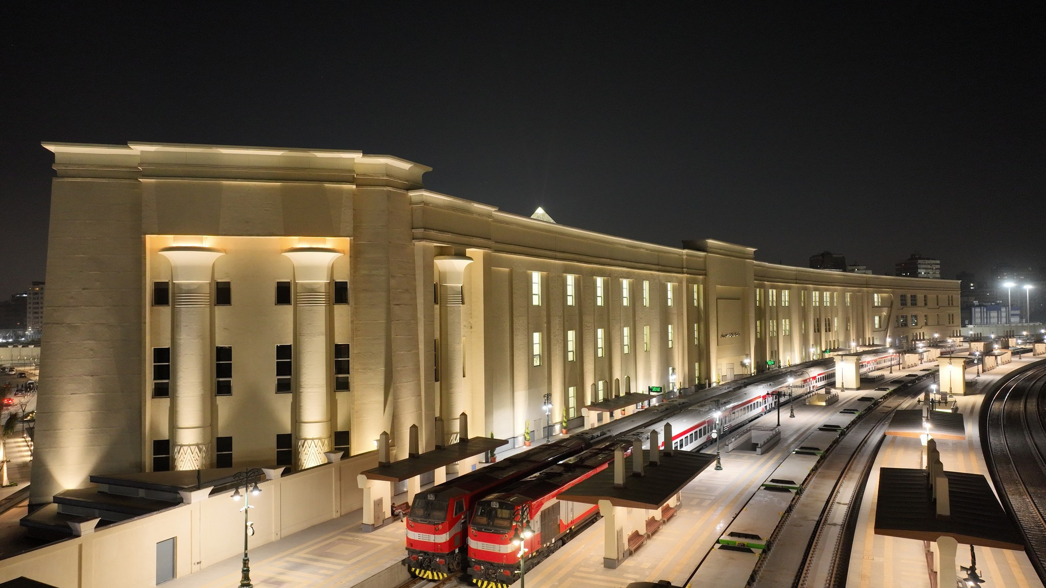
Thank You!
Thank You for Your Time & Attention
We sincerely appreciate your review of this project. Your insights help us craft experiences that are not just usable, but delightful. Every click, every scroll, and every interaction matters—and your feedback lights the way to make them better.

